Slide 1
General User Training
Presented By:
Lucía Lapaz, Brittany Ersery & Jim Holsinger
Envision Technology Partners, Inc.
September 2019

Slide 2
Agenda
Overview
Standard Navigation and Icons
Tips and Shortcuts
Patients Module
Immunizations Module
IZ Quick Add Module
Settings Module

Slide 3
WebIZ Modules
Patients
Immunizations
IZ Quick Add
Education
Inventory
Provider Management
Reports
VTrckS Interface
Administration
HL7 Management
Public Portal

Slide 4
Patients Module
Central repository shared by all users within the system
Tracks demographic information, local identifiers, patient programs, events, notes, exemptions precautions/contraindications, etc.

Slide 5
Immunizations Module
Manages all immunizations entered directly into the registry and imported through interface(s)
Recommender identifies vaccines needed based on a patient’s age, vaccine history, and current ACIP immunization schedules

Slide 6
IZ Quick Add Module
A “lite” version of the Immunizations module
Allows for simpler data entry when vaccines are administered in mass, such as at a flu clinic.

Slide 7
Education Module
Manages student enrollment/unenrollment within a school district and school
Tracks FERPA consent

Slide 8
Inventory Module
Provides 3 levels of inventory control at the Provider level
Tracks vaccine manufacturer, lot number, expiration date, NDC, and funding source
Ability to transfer inventory between inventory locations
Monthly inventory reconciliation process
Ability for clinics to submit vaccine orders and returns to the VFC program

Slide 9
Provider Management Module
Consists of two modules:
Clinic Tools
Programs Tools
Clinic Tools
Tracks temperature logging, clinic information change requests, VFC enrollments
Program Tools
Notes/case management tracking, creation of enrollment templates, manage submitted enrollments

Slide 10
Reports Module
Extensive reporting on a variety of information contained in the registry

Slide 11
User Settings
Found under username
Allows each user to set default values for various fields and customize some behaviors of the application

Slide 12
VTrckS Interface Module
Used to manage the VTrckS data exchange files:
Provider Master Data
Provider Ending Inventory
Vaccine Order Data
Vaccine Return Data
Wastage Data
Shipping Data

Slide 13
Administration Module
Contains a variety of screens used to control:
User access and security
Provider and Clinic locations
Customize system behavior/appearance
Perform various administrative tasks
These features are typically reserved for a subset of users
Modifying data in the Administration module can have far-reaching impacts to users throughout the system

Slide 14
HL7 Management Module
Search HL7 messages and registry responses
View messages in analyzer to resolve errors
Manage facility codes
Analyze HL7 message traffic

Slide 15
Public Portal
Allows patients to view their or their child’s Immunization record in SIMON.

Slide 16
System Requirements
Access the registry via your Internet browser:
Microsoft Internet Explorer (version 9 or above)
Google Chrome
Mozilla Firefox
Your PC must have Adobe Acrobat Reader installed to view PDF report output
Unique registry user name and password assigned to each user
Obtain log in information and/or request a user account from your SIMON Help Desk.

Slide 17
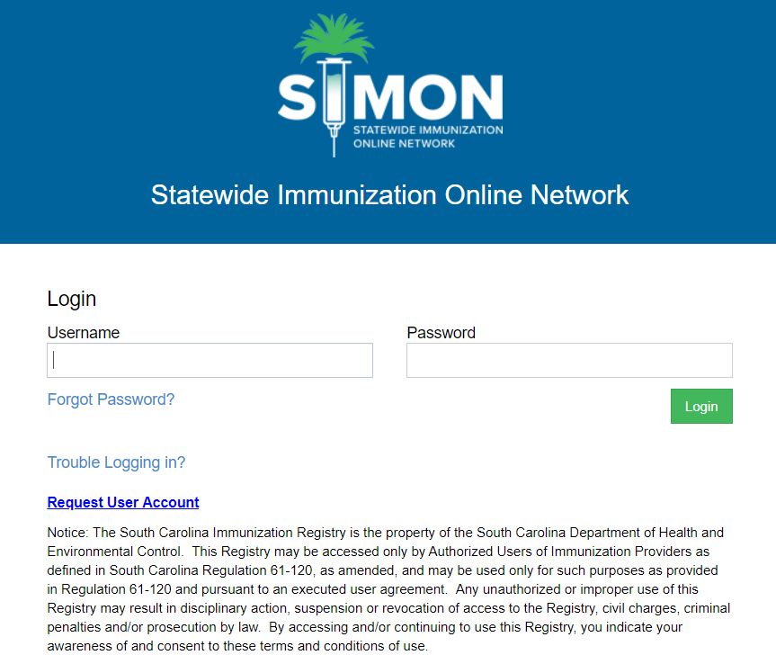
Log In
1
2
3
Enter Username
Enter Password
Click Login

Slide 18
Forgot Password
Click Forgot Password? to reset password.
1

Slide 19
Request User Account
Click to submit new user registration.
1

Slide 20
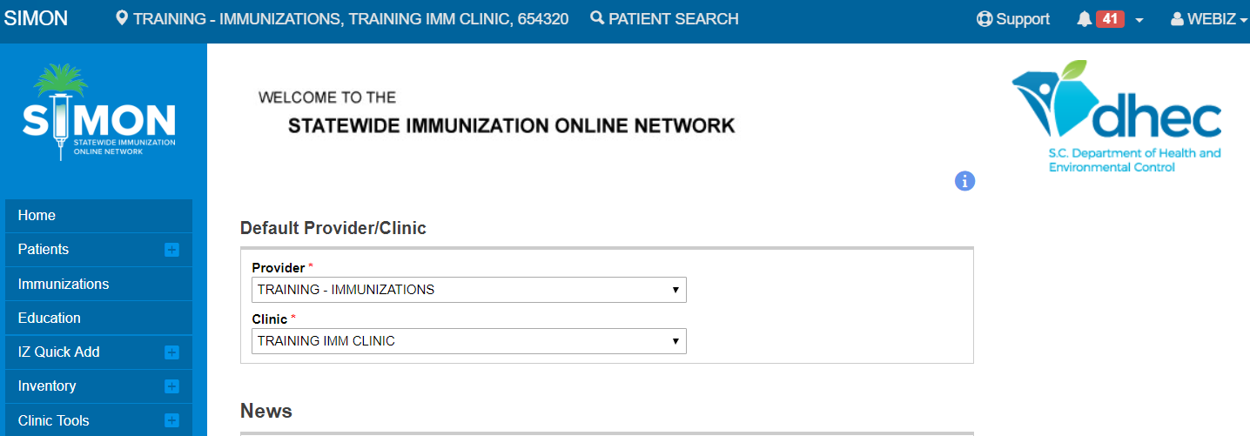
Home Screen
4
3
1
Select Provider
Select Clinic
Currently selected Provider/Clinic
Current User
Log Out link
2

Slide 21
Home Screen (cont.)
1
2
Patient Search
Main Menu / Modules
News
3

Slide 22
Standard Navigation
Use the Modules menu to navigate between modules/screens.
Click a Module with a + sign to expand the menu and view the screens within the module.
Once expanded, click a Module with a – sign to collapse the menu.
Avoid using the browser back and forward buttons.

Slide 23
Standard Navigation (cont.)
Search for existing records first.
Add a new record or update an existing record second.
Click the New Patient button to create a new record.
Double-click a line item or click the View button to display details and/or update an existing record.

Slide 24
Icons
 | Adverse Reaction | Vaccination has an adverse reaction documented.
 | Audit Information | Hover over to display user who created the record, user who last updated the record, and dates and times of changes.
 | Calendar | Click to display a pop-up calendar.
 | Clear | Click to clear text from data entry field.
 | Current User | Click to populate current user name into field. (Does not apply to global users.)
 | Deceased | Patient is deceased.
 | Deleted | Patient record has been deleted from the registry.

Slide 25
Icons (cont.)
 | Dose Not Administered | Vaccination has been added to patient’s record, but has not been administered and remains in on-hand inventory.
 | Exemptions | Patient has exemptions.
 | Historical Vaccination | Vaccination has been entered as a historical record and was not administered by a clinic in the registry.
 | Immunization Reconciled | Dose is included on an inventory reconciliation that has been closed.
 | Invalid Dose (Manual) | Vaccination has been manually invalidated by a user.
 | Invalid Dose (Recommender) | Vaccination has been marked as invalid by the recommender.
 | Lookup | Click to search for a patient record.

Slide 26
Icons (cont.)
 | Notes | Patient record includes notes.
 | Online Help | Click to view online help for the page.
 | Opted Out | Patient has chosen not to participate in the IIS.
 | Precautions / Contraindications | Patient has one or more allergies or risks that may impact recommended immunizations.
 | Print | Click to view a PDF of the associated report, which can then be printed.
 | Vaccination Comments | Vaccination has comments.
 | Warning | Appears with a warning or other informational message.

Slide 27
Tips and Shortcuts
Keyboard shortcuts
Use the Tab key to navigate to the next data entry field
Press Shift + Tab to navigate to the previous field
Copy text: Ctrl + C
Paste text: Ctrl + V
Cut text: Ctrl + X
On most screens, fields with a bold label followed by a red asterisk are required.

Slide 28
Tips and Shortcuts (cont.)
Date fields
Enter numbers only, slashes are automatically inserted to satisfy required MM/DD/YYYY format
Double-click a date field to auto-populate the current system date
Default action button
Highlighted in green
Press Enter key to perform default action

Slide 29
Log In
Hands-On Exercise

Slide 30
Patients Module

Slide 31
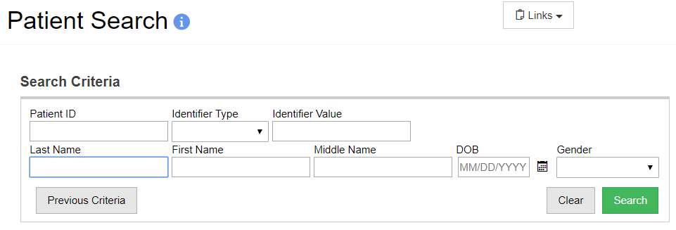
Patient Search
1
2
Auto-fill criteria used during last search.
Perform search.

Slide 32
Patient Search (cont.)
Minimum search criteria:
Patient ID
Identifier type and value
Patient date of birth (user security function required)
Two or more letters of patient first and last names

Slide 33
Patient Search Results
1
2
Double-click a record to view Patient Demographics, or select a record and click a button to navigate to the respective screen.
If the record is not found, click to create a New Patient in the registry.

Slide 34
Add New Patient
1
2
Complete required fields: Last Name, First Name, Date of Birth (DOB), and Gender.
Click Create.

Slide 35
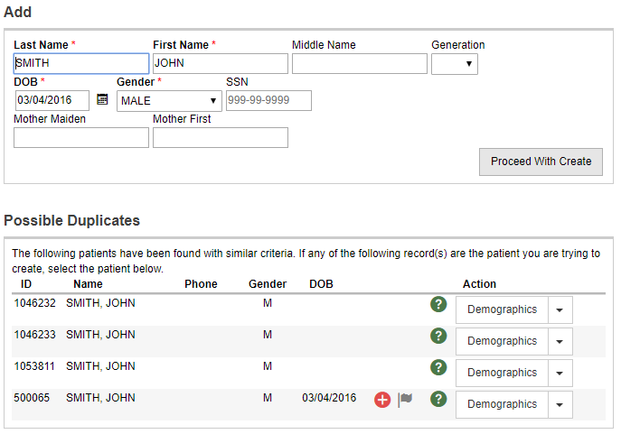
Possible Duplicates
Possible duplicate patients are identified.
If the patient is not in the possible duplicates list, click Proceed with Create.
2
1

Slide 36
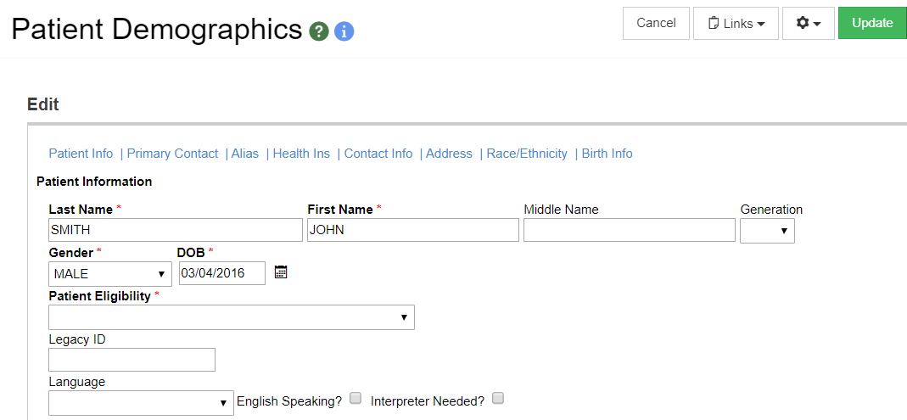
Add New Patient (cont.)
2
1
Complete required fields on Demographics screen.
Click Update.

Slide 37
Patient Demographics
1
2
3
4
Patient Header
Links to Patient Reports/Forms
Links to open new windows to manage/view additional patient info
Links to different sections of demographics screen

Slide 38
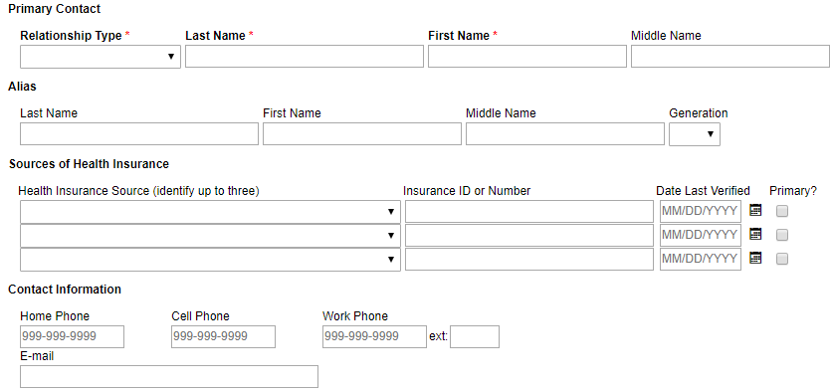
Patient Demographics (cont.)
1
2
3
4
Enter Primary Contact (Emergency Contact)
Enter patient Alias
Record up to 3 Sources of Health Insurance
Enter patient Phone number(s) and/or E-mail
Notes:
Note: Primary Contact required for patients less than 18 years of age.

Slide 39
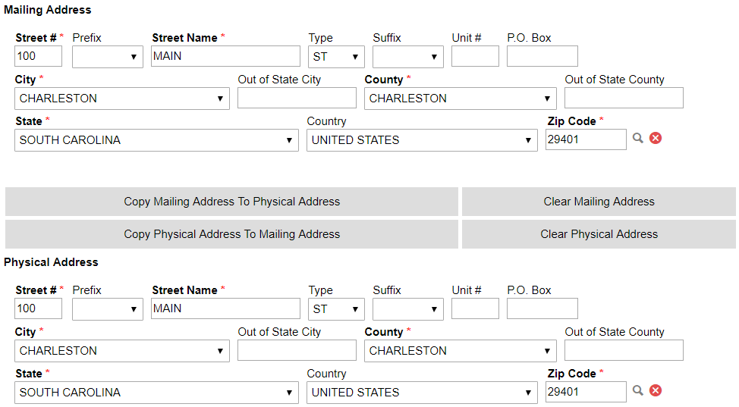
Patient Demographics (cont.)
Mailing Address and Physical Address are required
City/County/ZIP mappings are maintained by administrators in the system code tables

Slide 40
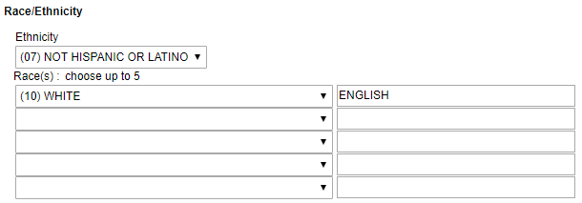
Patient Demographics (cont.)
1
2
3
Select patient Ethnicity.
Select patient Race(s).
Enter any Comments describing the Race.

Slide 41
Patient Demographics (cont.)
Birth Information (some from Vitals import, some entered manually)

Slide 42
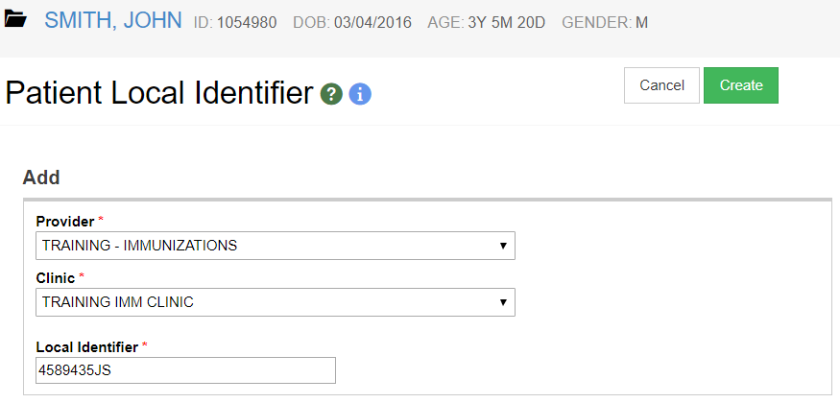
Patient Local IDs
Enter one local identifier per Provider/Clinic.
Standard values are 15 characters or less. Longer values may be truncated during electronic exchange.
Notes:
Providers will typically have their own unique identifier for each of their patients. This could be a medical record number, a chart number, an identifier assigned by their internal EMR/EHR system, etc. The Patient Local Identifier screens allow a provider/clinic to associate their own identifier to the corresponding record in the Registry. This information can be used when searching the Registry. Only those users associated to a provider/clinic will have access to this data.

Slide 43
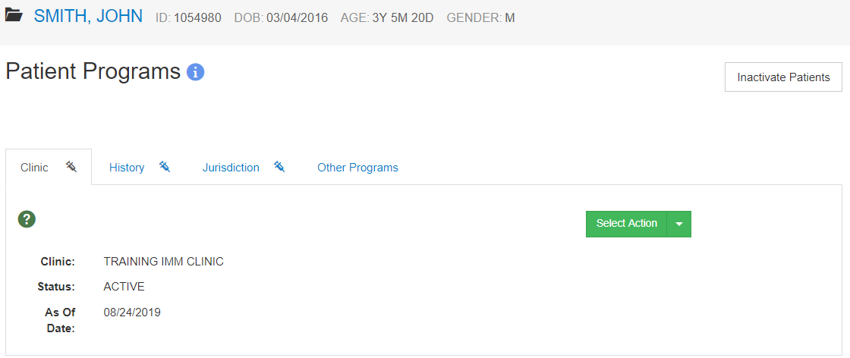
Patient Programs
Patient Programs screen supports both Clinic Status and Jurisdiction Status.
Notes:
WebIZ can be extended to support multiple Public Health programs. The core patient record (demographics, notes, local IDs, events, etc.) is shared across all programs.
WebIZ automatically registers a patient in the Immunization program when the first immunization is given to a patient. You can refer to the Programs screen to view the registration date. If programs other than Immunization are using the patient registration capabilities of WebIZ, you may see that a patient is registered in additional programs.
Note: If a patient has been marked as inactive but receives an administered immunization after the program close date (and as long as default provider takes ownership) then the system will automatically remove the close date and close reason and the patient will be active again.

Slide 44
Clinic Status Options
Active
Inactive – No Longer a Patient
Auto-selected if a patient’s default clinic changes as a result of an administered vaccination
Manual updates allowed on Patient Programs page and/or Inactivate Patients report
Inactive – Lost to Follow Up
Patients included in at least 3 reminder/recalls AND
Patients with no vaccinations in the last 120 days
Deceased
Opted Out
Notes:
New code table ‘IZ Program Status Reason Codes’ – only Display order is editable. All values are system-reserved.

Slide 45
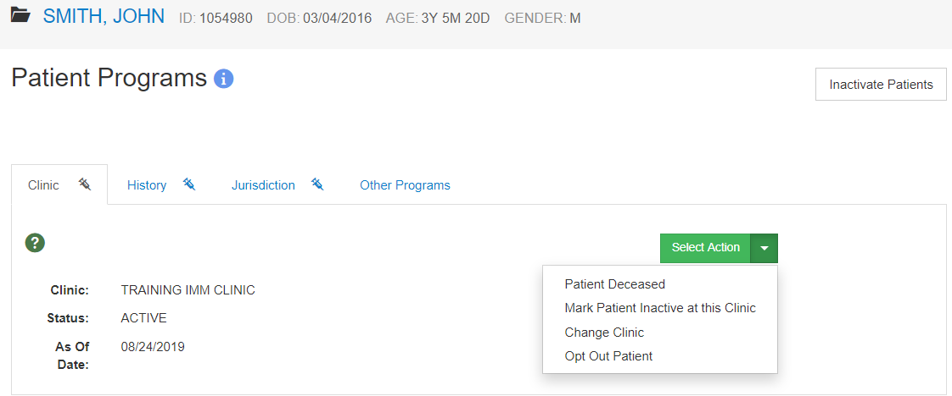
Update Clinic Status
1
2
Mark Patient Deceased (requires EDIT DECEASED SF)
Mark Patient Inactive at Clinic (No Longer a Patient) – requires Modify Patient Program Enrollments SF
Notes:
SF = security function

Slide 46
Update Clinic Status (cont.)
1
2
Change Clinic where patient is Active – requires Modify Patient Program Enrollments SF
Opt Out Patient (requires EDIT OPT OUT PATIENT SF)
Notes:
SF = security function

Slide 47
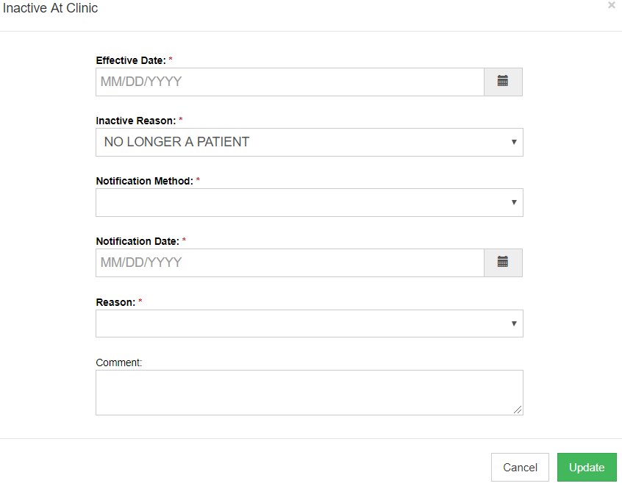
Mark Patient Inactive at Clinic
Notes:
Notification Method = controlled by new code table ‘IZ Program Communication Method Codes’
No Longer A Patient Reason = controlled by new code table ‘IZ Program No Longer A Patient Reasons’ – reason OTHER is system-reserved.
If Reason = Other, Comment is required.

Slide 48
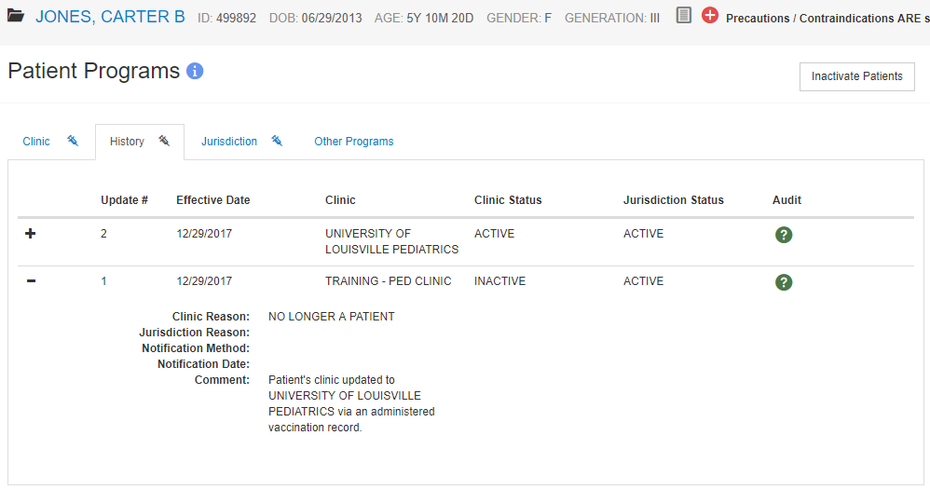
Patient Programs History
Notes:
If a patient’s clinic changes for any reason, a record of the patient becoming inactive with their current clinic will be displayed and a new record created as active with the new clinic.

Slide 49
Jurisdiction Status Options
Active
Inactive (Outside Jurisdiction)
Unknown (No Address – No Vaccination)
Unknown (No Activity for Extended Period of Time)
Deceased
Opted Out
Notes:
New code table ‘IZ Program Status Reason Codes’ – only Display order is editable. All values are system-reserved.

Slide 50
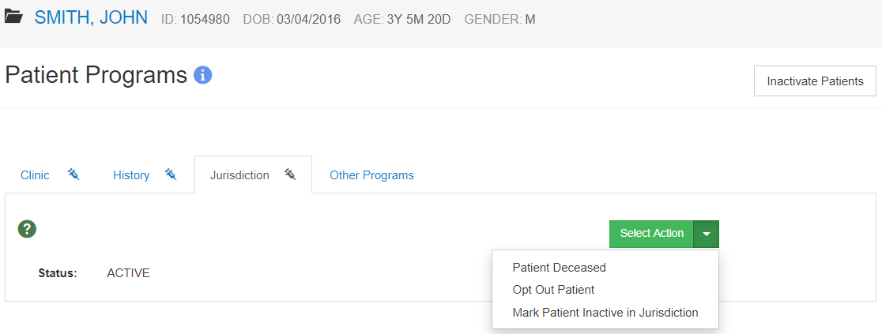
Update Jurisdiction Status
1
2
3
Mark Patient Deceased (requires EDIT DECEASED SF)
Opt Out Patient (requires EDIT OPT OUT PATIENT SF)
Mark Patient Inactive in Jurisdiction – requires Modify Patient IZ Status – Jurisdiction SF
Notes:
SF = security function

Slide 51
Patient Emergency Contacts
1
2
Add a new emergency contact.
View and/or edit an existing emergency contact.

Slide 52
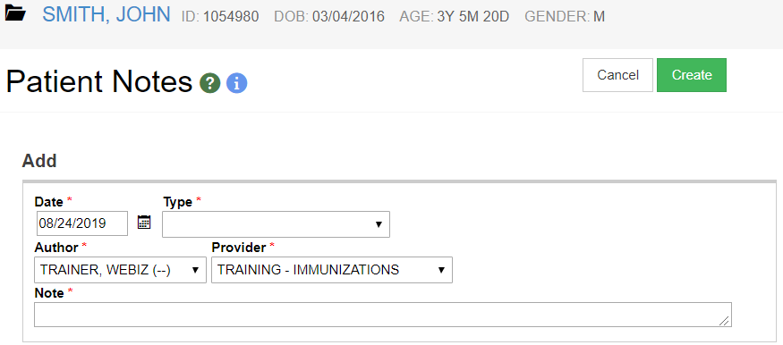
Patient Notes
The note type determines if the note is visible to all users and/or if the note prints on the patient shot card.
Notes:
The Patient Notes screens allow you to enter and categorize additional information about a patient. Some notes (e.g., Vaccine Refusals) can be generated automatically by the system.
Please be aware that some notes have special implications. For example, some note types are printed on the official immunization record. Other types may be visible to all users of the system or only a subset. Be cognizant of the note text associated with any note type that may be visible to users outside of your organization.

Slide 53
Precautions / Contraindications
View/enter any precautions or contraindications that may impact vaccines administered to a patient.
Recommender uses CDSi logic to follow or ignore recommended immunizations based on associated precautions / contraindications.
Notes:
The Patient Precautions/Contraindications screens allow you to view and enter any precautions or contraindications that may impact the vaccines that could be administered to a patient. The Recommender is configured according to CDSi logic, and will not forecast certain immunizations based on the patient having an associated contraindication. The Recommender also only considers the contraindication from the effective date to the expiration date when set.

Slide 54
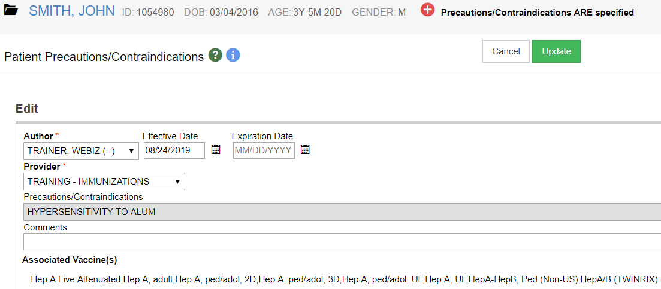
Precautions/Contraindications (cont.)
Vaccines potentially impacted by the precaution / contraindication.

Slide 55
Patient Events
Events can be added by WebIZ automatically, such as when a reminder is generated.
Events can also be manually added by users, such as when a HIPAA notice is given to the patient.
Notes:
The Patient Events screens allow you to view and update information about events that pertain to the patient and are associated with a particular date. Typical event types include acknowledgement of a HIPAA notice These can be added by the system (e.g., when the reminder dates are generated) or manually (e.g., for non-vaccine events).

Slide 56
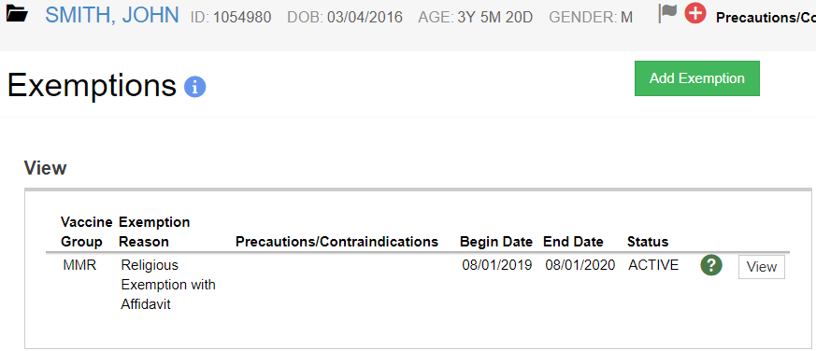
Patient Exemptions
Track vaccine exemptions per patient.
Exemption reasons are managed on the Vaccination Refusal Reason Codes table.
Notes:
If the exemption is for medical reasons, the associated precaution and/or contraindication is automatically added to the patient record.
Exemptions do not affect recommended vaccines and are only used for reporting purposes.

Slide 57
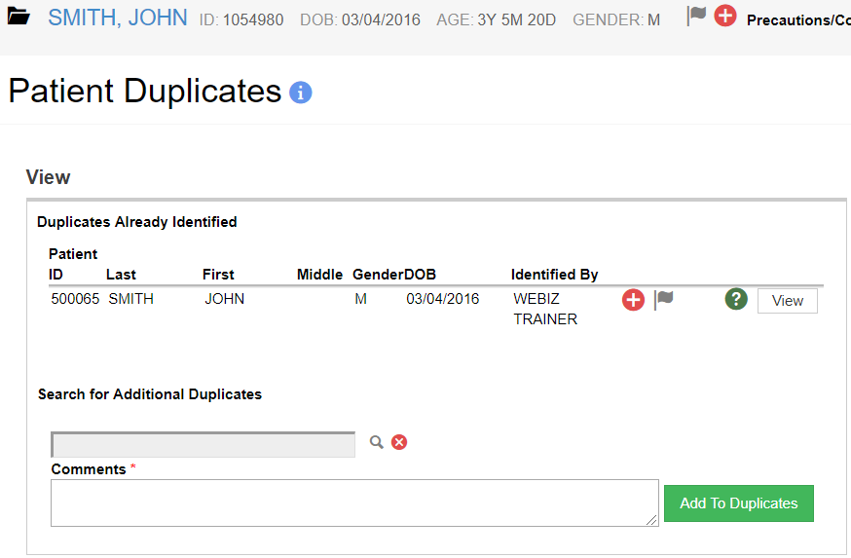
Patient Duplicates
Search for duplicate patient.
Enter Comments.
Click Add to Duplicates.
Compare patients.
4
1
3
2
Notes:
End users can identify potential duplicate patients for administrators to review and either combine or mark as not duplicate.

Slide 58
Add New Patient
Hands-On Exercise

Slide 59
Immunizations Module

Slide 60
Immunizations Home
View recommended immunizations
View immunization history
Add / administer immunizations
Print patient records

Slide 61
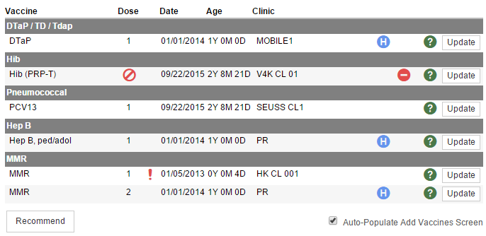
Immunization History
1
2
3
4
5
Vaccine name.
Dose number in series.
Date vaccine given.
Patient age at vaccination.
Clinic administering immunization.
Click to recommend immunizations.
6

Slide 62
Immunization Recommendations
Click the Recommend button on the Immunizations Home screen to display immunization recommendations in a new window, including:
Precautions / Contraindications
Immunization History
Recommended immunizations for today
Future recommendations
Option to Print the recommendations

Slide 63
Add Immunization History
Enter immunizations from a patient’s paper record into WebIZ
DO NOT use the Add History screen to record immunizations administered at the clinic!
Historical immunizations DO NOT decrement from inventory
Historical immunizations ARE NOT counted on certain reports

Slide 64
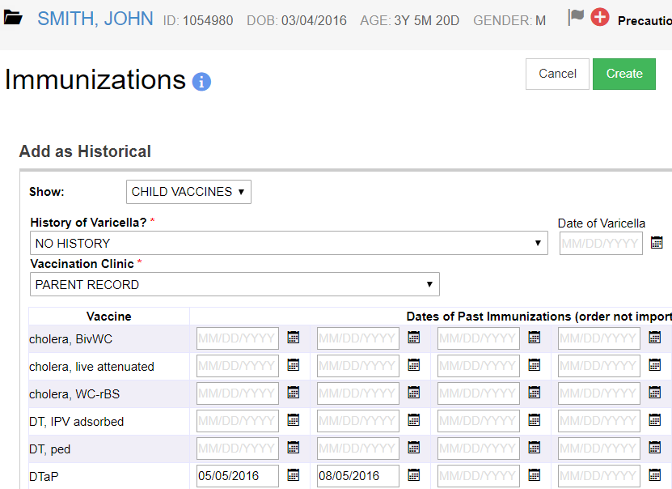
Add Immunization History (cont.)
1
2
3
Display CHILD or ALL vaccines.
Record History of Varicella and Date.
Clinic where immunization was given.
Enter Date(s) of Past Immunizations.
4

Slide 65
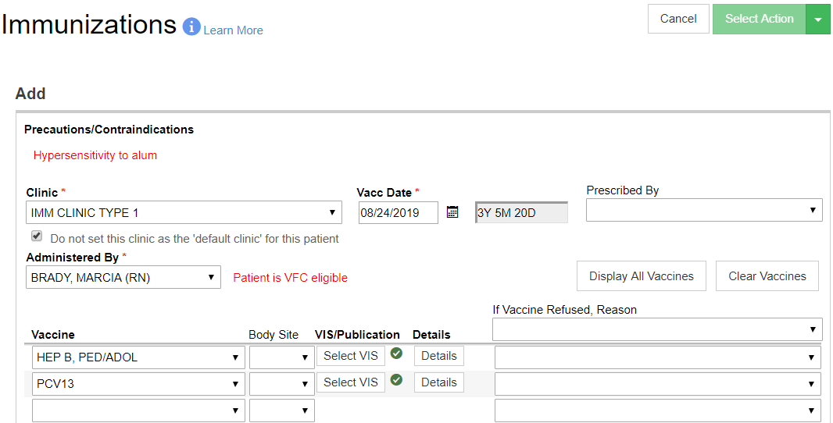
Quick Add (Type 1 Clinics Only)
Select vaccination Clinic.
Enter Vacc Date.
Select if the vaccination clinic should NOT take ownership of patient.
Indicate who Administered the vaccination(s).
1
2
3
4
Notes:
Remember: Quick Add DOES NOT decrement from inventory! No tracking of manufacturer, lot, etc.

Slide 66
Quick Add (Type 1 Clinics Only)
Indicate who Prescribed the vaccine.
Select the Vaccine given or refused.
If given, indicate the Body Site.
Select VIS.
Click to add additional vaccine details.
1
3
4
5
2
Notes:
Remember: Quick Add DOES NOT decrement from inventory! No tracking of manufacturer, lot, etc.

Slide 67
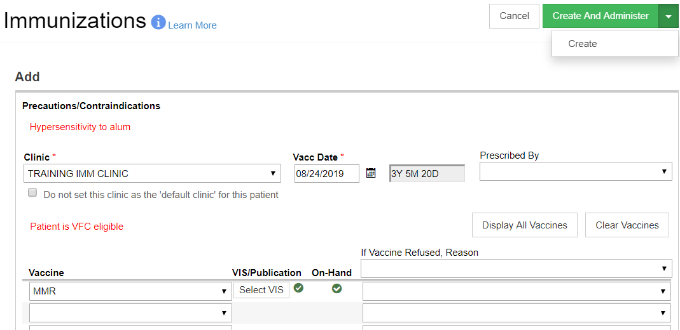
Add Immunization (Types 2 & 3)
3
1
2
4
Click to display ALL vaccine types.
Click to select an alternate VIS.
Click to add vaccine(s) for later admin.
Click to select if vaccine was refused.
Notes:
Option to document vaccine refusal(s) and reason(s). Notes are automatically added to patient record.

Slide 68
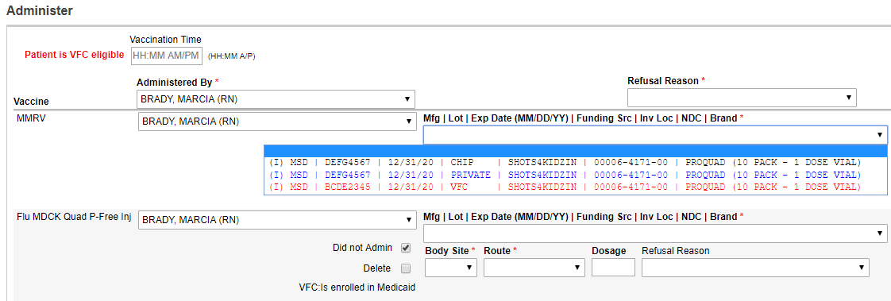
Administer Immunization
1
2
Indicate who administered the vaccine.
Select the lot number administered.
68

Slide 69
Administer Immunization (cont.)
1
2
3
Indicate the Body Site where vaccine was administered. (Route and Dosage default, but can be changed.)
Document vaccine Refusal Reason, if refused.
If funding source does not match patient eligibility, enter a Borrowed Reason and Comment.

Slide 70
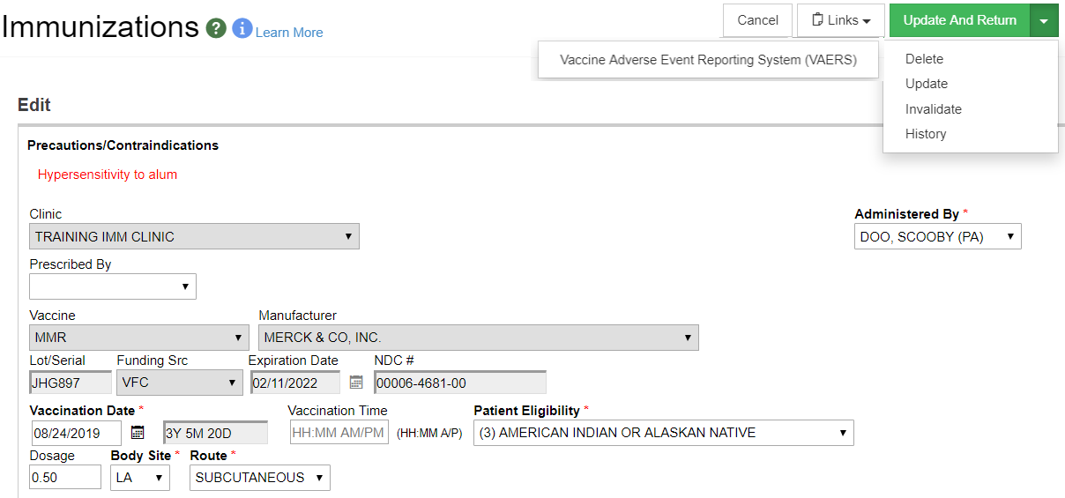
Immunization Details
1
2
3
Click link to open VAERS website.
Click to mark immunization as invalid.
Click to view history of changes to this immunization.

Slide 71
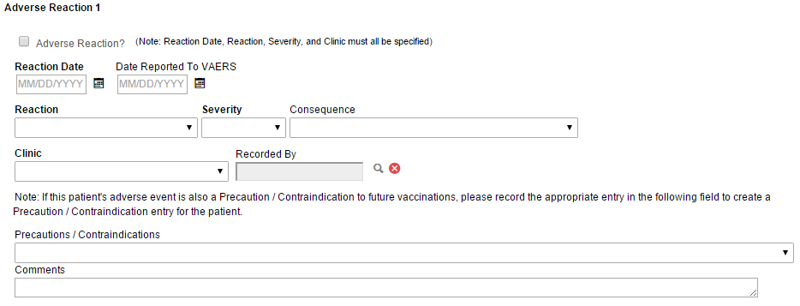
Immunization Details (cont.)
Document up to 3 adverse reactions per immunization.

Slide 72
Immunization Details (cont.)
1
2
Enter any Notes about the immunization.
Click to change the VIS associated with the immunization

Slide 73
Administer Immunization
Hands-On Exercise

Slide 74
IZ Quick Add Module

Slide 75
IZ Quick Add Module
Used to administer immunizations to patients in mass
Does not decrement inventory
Includes “lite” versions of WebIZ modules/screens:
Patient Search
Demographics
Immunizations
Mass Events

Slide 76
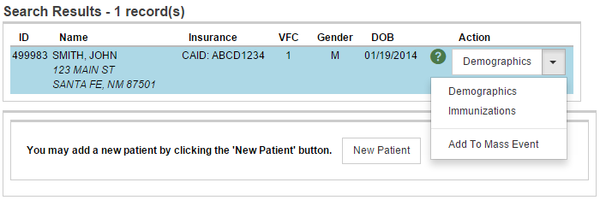
IZ Quick Add
1
2
3
4
Click on the desired patient to highlight.
Click to view the IZ Quick Add Demographics screen.
Click to view the IZ Quick Add Immunizations screen.
Click to view the IZ Quick Add Mass Event screen.

Slide 77
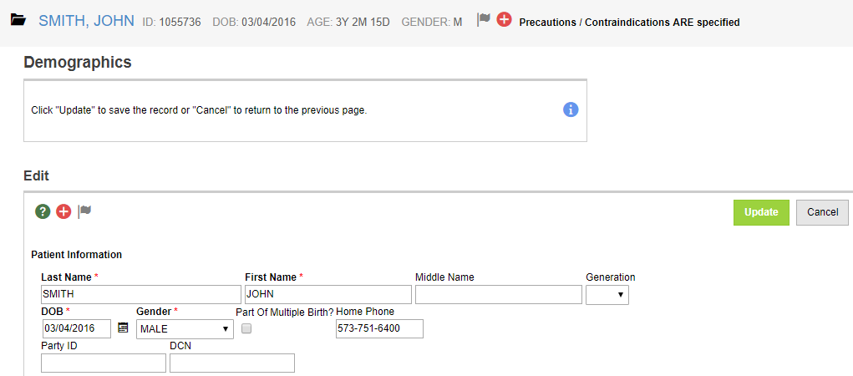
IZ Quick Add Demographics
Contains fewer required fields than the main Patient Demographics screen.

Slide 78
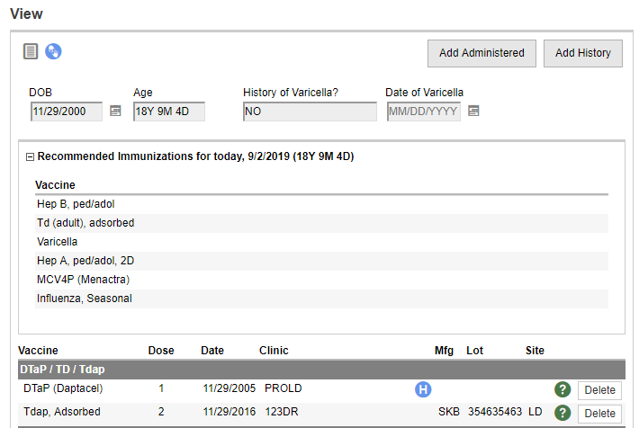
IZ Quick Add Immunizations
1
2
Click to add immunization(s) to the patient record.
Click to add historical immunizations, e.g., from a paper record.

Slide 79
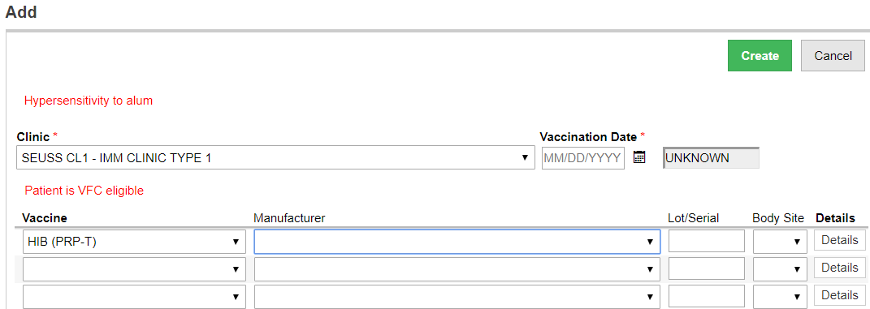
Quick Add
1
2
Enter the Date the immunization was administered.
Select the Vaccine administered. (Manufacturer, Lot Number, and Body Site are optional fields.)

Slide 80
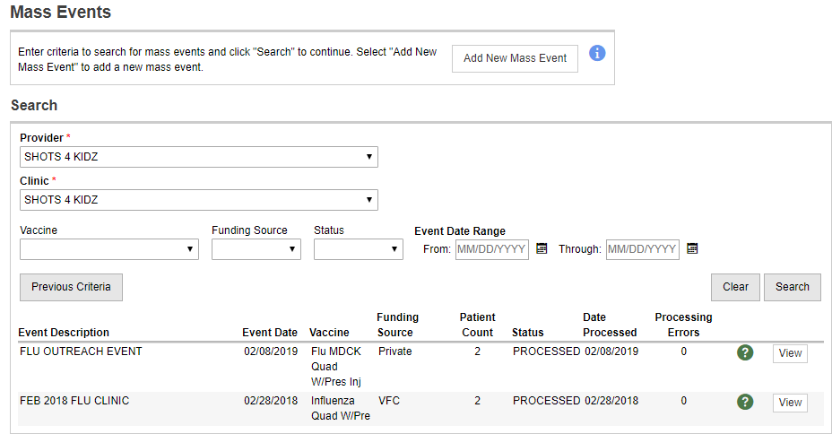
Mass Event Search
1
2
3
Click to create a new mass event.
Enter search criteria.
Click to search for all mass events matching search criteria.

Slide 81
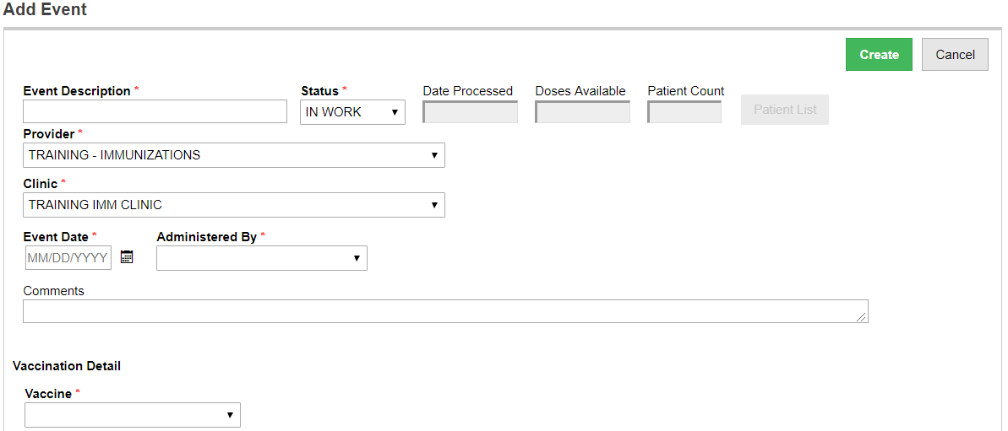
Add New Mass Event
1
2
3
4
Enter an Event Description
Select Provider/Clinic
Enter the Event Date
Select Administered By

Slide 82
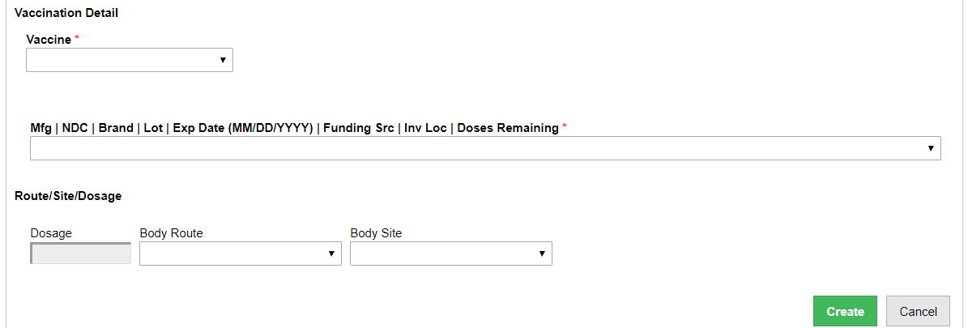
Add New Mass Event (cont.)
1
2
3
4
Select Vaccine type.
Select Lot from inventory on-hand.
Enter Dosage, Body Route and Body Site.
Click Create.

Slide 83
Add Patient to Mass Event
Click Patient List to view/modify patients belonging to the event.

Slide 84
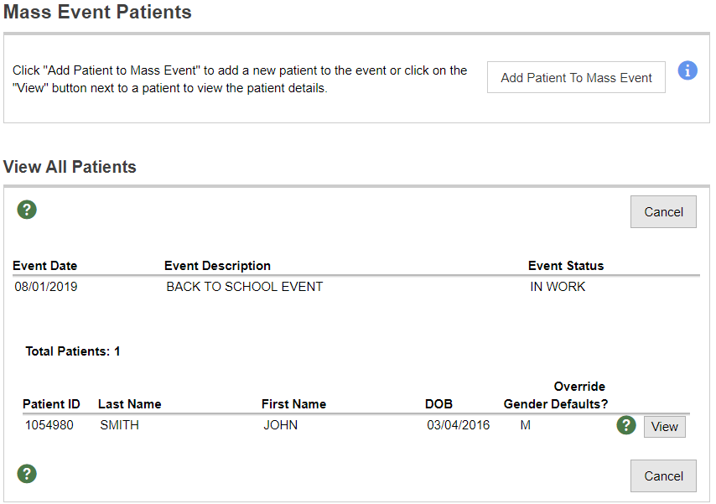
Add Patient to Mass Event (cont.)
1
2
Click to add patients to the mass event.
Click to view/edit mass event patient.

Slide 85
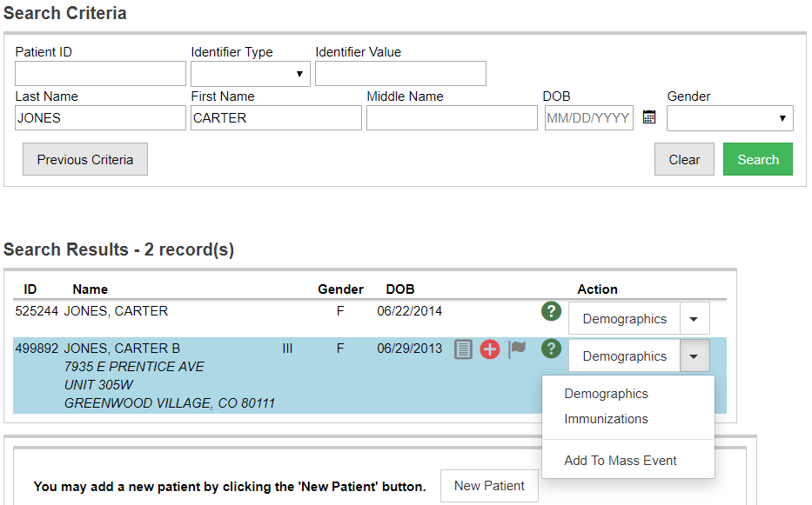
Add Patient to Mass Event (cont.)
Search for a patient.
Select patient from search results.
Create new patient if no matches found.
Click to add patient to mass event.
1
2
4
3

Slide 86
Submit Mass Event for Processing
Once all patients have been added to the mass event, change Status to ‘SUBMITTED’ and click Update.
Notes:
Mass Events job runs overnight. The job adds vaccinations to all patients belonging to the event, as well as decrements doses administered from inventory on-hand.

Slide 87
Quick Add
Hands-On Exercise

Slide 88
Settings Module

Slide 89
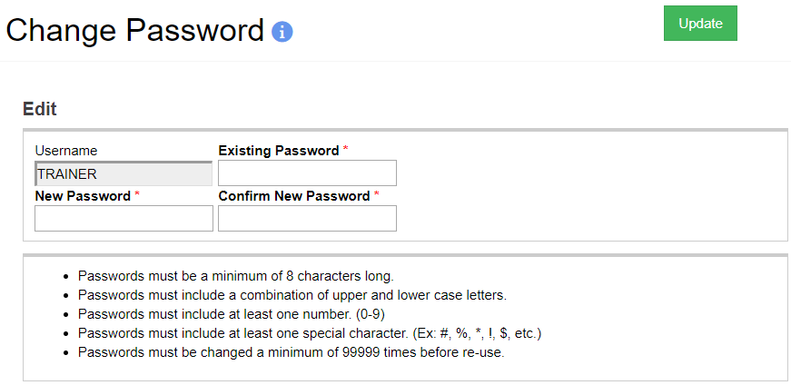
Change Password
3
1
2
Enter current password.
Enter new password twice. (Follow password rules at bottom of screen.)
Click Update.

Slide 90
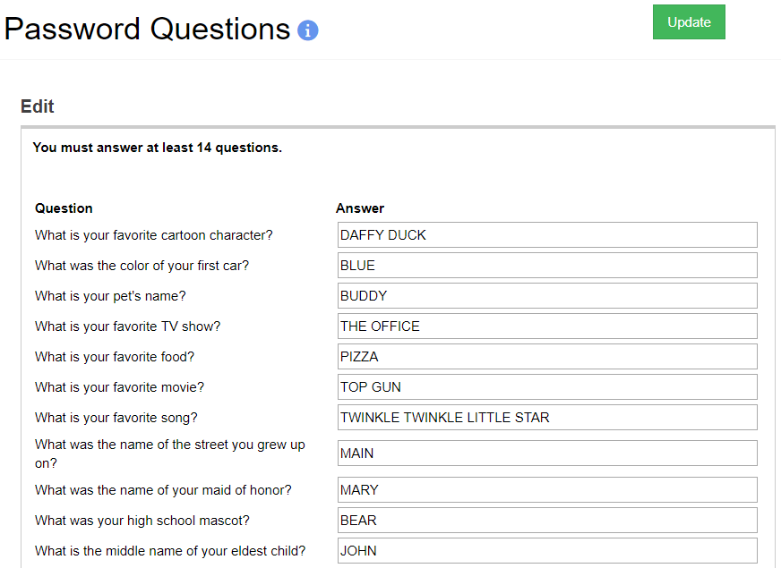
Update Password Questions
2
1
Answer at least 14 questions.
Click Update.

Slide 91
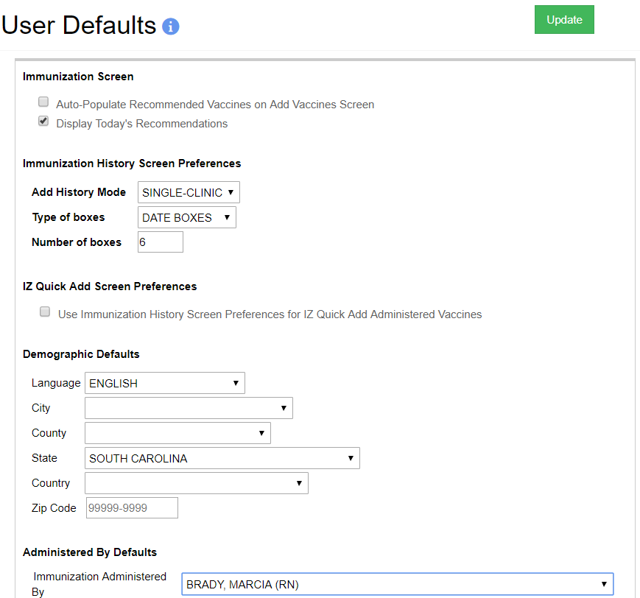
Set User Defaults
Customize user-specific default behaviors on certain screens.

Slide 92
Clinic/User Vaccine Defaults
Used by Type 2 clinics to maintain vaccine inventory.
Used by Type 3 to auto-populate preferred lot numbers when administering.
Users select a lot number from this catalog when administering immunizations.

Slide 93
User Default Settings
Hands-On Exercise

